Slide 1
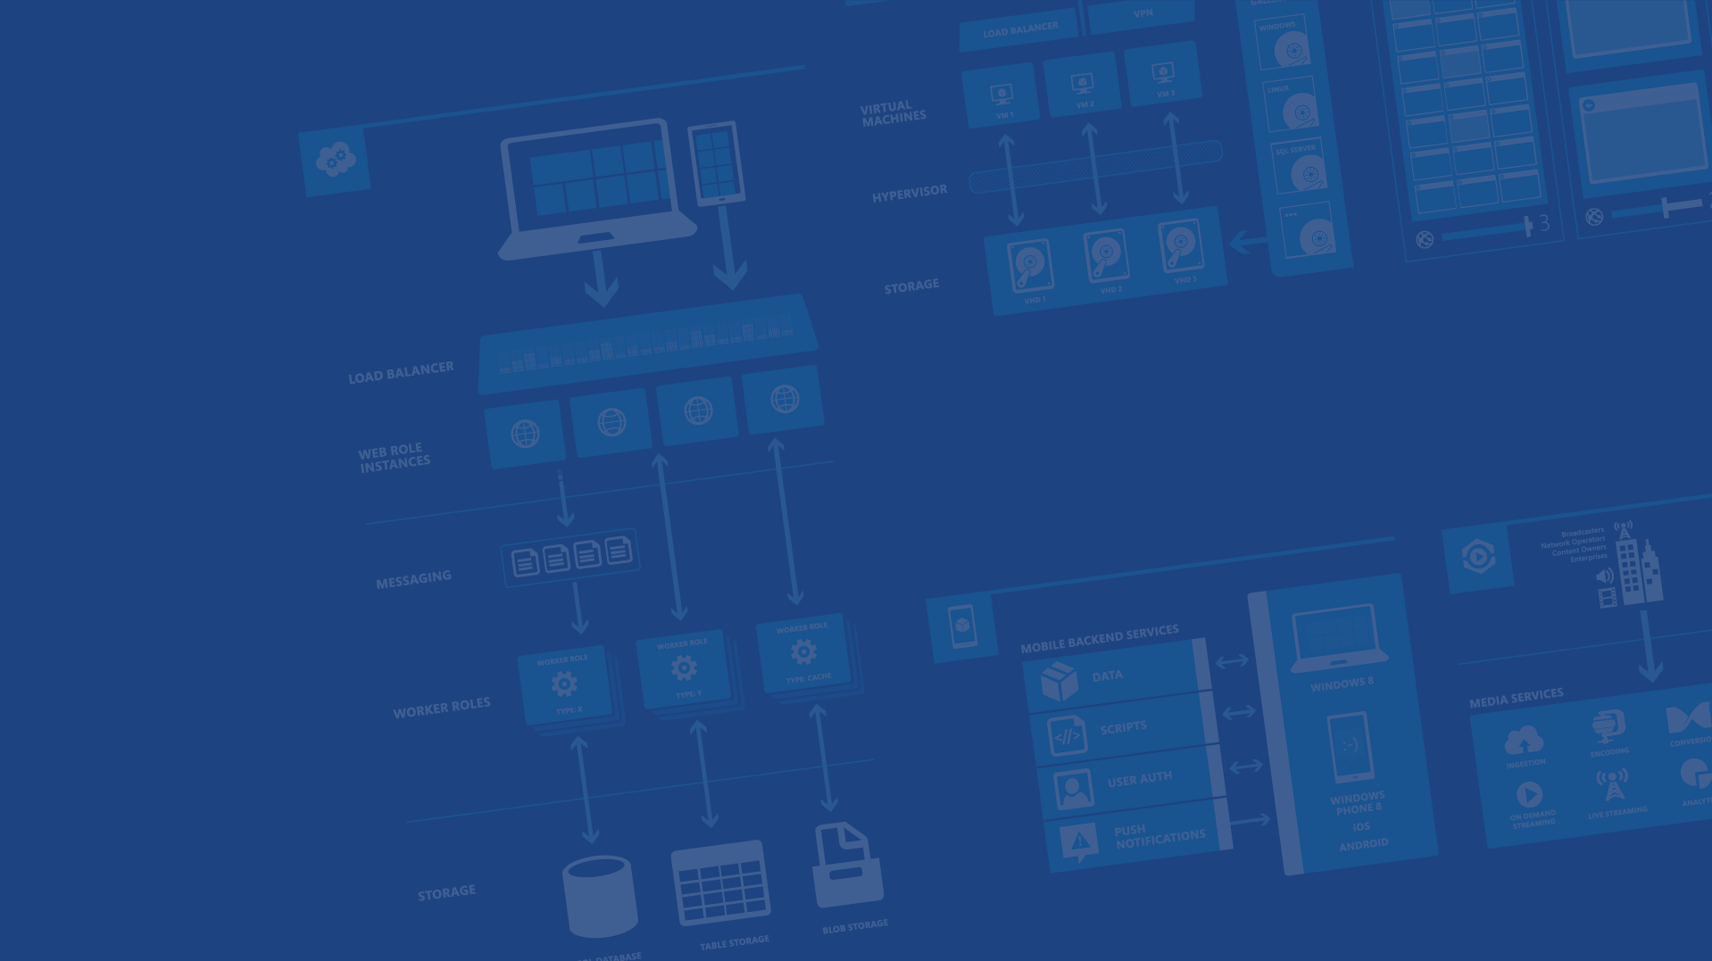
Azure IaaS
Presenter Name
Position or role
Microsoft Azure
Notes:
Presentation Objectives:
This presentation provides a high-level overview of Azure IaaS. It covers essential concepts and tools for people who are new to Azure to get started. It covers both Virtual Machines and Virtual Networks.
Speaker Notes:
It’s important for the speaker to reiterate the first segment, which should have been covered by the “Design Cloud Solutions” session earlier.
Given there are lots of contents to be covered, the speaker should focus on only high-level concepts instead of drilling too much into details.

Slide 2
Agenda
Virtual machines
Virtual Networks
Availability Sets
Scaling
Notes:
Slide Objectives:
Explain the agenda of the session.
Speaker Notes:
Explain this presentation is a high-level overview, so not everything is covered in-depth.

Slide 3
Your service
Notes:
Slide Objectives:
Explain how Azure helps developers to refocus on their applications.
Speaker Notes:
Before we discuss about specifics, let’s refocus on what you care about – your application/service.
Azure is taking a application-centric approach and brings tools and services to support DevOps scenarios.

Slide 4
→ Your application code
→ Your infrastructure code
→ Required resources
Notes:
Slide Objectives:
Explain application is made up by application code and infrastructure code.
Speaker Notes:
Let’s start with something that you know inside-and-out: your application code. [click]
Then, for whatever reason, you decide to deploy your application to Azure. [click]
What you do is to allocate a bunch of related resources out of the humongous resource pool provided by Azure, deploy your application code to these resources, and you have a running service. [click]
For DevOps’ perspective, you need a way to reliable capture and apply your requirements on resources, which can be referred as infrastructure code.

Slide 5
You: Code (application, infrastructure)
Azure: Resources (IaaS, PaaS, SaaS)
Notes:
Slide Objectives:
Reiterate the point that to make your service successful, you are partnering with Azure. You bring the code, and Azure brings resources.
This slide also sets state for the talk by explaining how IaaS components fit into the overall picture.
Speaker Notes:
[Continue with previous slide]
To make your service successful, you are partnering with Azure. You bring the code, and Azure brings resources. [Click]
And you keep iterating and making improvements over time. [Click]
In terms of infrastructure code, you can use it to define desired states of required resources (Note: current Azure Resource Manager only support a small number of Resource Providers). [Click]
You can define hosting environments, such as websites, cloud services and VMs. [Click]
Required services. [Click]
In this session we’ll focus on infrastructural components including virtual machines and virtual networks.

Slide 6
Virtual Machines

Slide 7
Azure Virtual Machines
→ Launch Windows Server and Linux in minutes
→ Scale from 1 to 1000s of VM Instances
→ Save money with per-minute billing
→ Open and extensible
Notes:
Slide Objectives:
High-level selling points of virtual machines.
Speaker Notes:
Both Linux and Windows are supported. It’s important to reiterate on this as many developers are still not aware of this.
Mention scaling at enterprise level using DSC, Puppet or Chef.
Emphasize on the openness – we are not forcing your to lock on Microsoft technologies. Instead, Azure is more open than ever. You can leverage your existing skills, tools and services, and Azure is providing more and more first-class supports for them.

Slide 8


Provisioning VM
Getting Started
Select Image and VM Size
New Disk Persisted in Storage
Windows Server
Management Portal
Boot VM from New Disk
Linux
>_
General Purpose
Basic
Standard
Optimized Compute
Performance Optimized
Network Optimized
Scripting
(Windows, Linux and Mac)
Cloud
REST API
Notes:
Slide Objective:
Explain workflow for provisioning VMs in the cloud
Speaker Notes:
You have three methods of starting this process: Build a VM from the portal, from the command line OR programmatically calling the REST API.
Once your choice of provisioning is made you will need to select the image and instance size to start from.
The newly created disk will be stored in blob storage and your machine will boot.

Slide 9

















VM Gallery
A collection of prebuilt images for various workloads
Windows Server 2012 R2
Ubuntu Server 14.04 LTS
CentOS 6.5
SUSE Linux
Enterprise Server
openSUSE 13.1
Oracle Linux 6.4.0.0.0
SQL Server 2014 Standard
Oracle Database 11g R2
SharePoint Server Farm
Microsoft Dynamics
GP 2013
Zulu 8
BizTalk Server 2013
SAP HANA
Developer Edition
Puppet Enterprise 3.2.3
Barracuda Web Application
Oracle WebLogic
Server 12.1.2
Visual Studio Ultimate 2013
Windows 8.1 Enterprise
Microsoft Azure
Notes:
Slide Objective:
Explain a wide variety of images that you can choose from.
Speaker Notes:
First of all, you can choose from different Windows Servers and a variety of Linux implementations. [Click]
As well as pre-built images for different flavors of SQL Database and Oracle databases. [Click]
You can also choose from a number of first-party and certified third-party images for various application servers and infrastructural components. [Click]
And last but not least, if you are a MSDN subscriber, you also have access to Visual Studio images and client Windows systems such as Windows 7 and Windows 8.1 for your DevTest purposes.

Slide 10
Virtual Machine Sizes
General Purpose compute: Basic
General Purpose compute: Standard
Optimized Compute
Performance Optimized
Network Optimized
Notes:
Slide Objective:
Introduce different virtual machine sizes.
Speaker Notes:
Basic is limited to A0-A4, lower disk speed and does not include load balancing or auto-scaling, but is cheaper
http://azure.microsoft.com/en-us/pricing/details/virtual-machines/

Slide 11
General purpose compute: Basic tier
An economical option for development workloads, test servers, and other applications that don't require load balancing, auto-scaling, or memory-intensive virtual machines.
Instance | Cores | RAM | Disk sizes
A0 | 1 | 0.75 GB | 20 GB
A1 | 1 | 1.75 GB | 40 GB
A2 | 2 | 3.5 GB | 60 GB
A3 | 4 | 7 GB | 120 GB
A4 | 8 | 14 GB | 240 GB

Slide 12
General purpose compute: Standard tier Offers the most flexibility. Supports all virtual machine configurations and features
Instance | Cores | RAM | Disk sizes
A0 | 1 | 0.75 GB | 20 GB
A1 | 1 | 1.75 GB | 70 GB
A2 | 2 | 3.5 GB | 135 GB
A3 | 4 | 7 GB | 285 GB
A4 | 8 | 14 GB | 605 GB
A5 | 2 | 14 GB | 135 GB
A6 | 4 | 28 GB | 285 GB
A7 | 8 | 56 GB | 605 GB

Slide 13
Optimized compute 60% faster CPUs, more memory, and local SSD
Instance | Cores | RAM | Disk sizes
D1 | 1 | 3.5 GB | 50 GB
D2 | 2 | 7 GB | 100 GB
D3 | 4 | 14 GB | 200 GB
D4 | 8 | 28 GB | 400 GB
D11 | 2 | 14 GB | 100 GB
D12 | 4 | 28 GB | 200 GB
D13 | 8 | 56 GB | 400 GB
D14 | 16 | 112 GB | 800 GB

Slide 14
Performance optimized compute Unparalleled computational performance with latest CPUs, more memory, and more local SSD
Instance | Cores | RAM | Disk sizes
G1 | 2 | 28 GB | 384 GB
G2 | 4 | 56 GB | 768 GB
G3 | 8 | 112 GB | 1,536 GB
G4 | 16 | 224 GB | 3,072 GB
G5 | 32 | 448 GB | 6,144 GB

Slide 15
Network optimized Fast networking with Infiniband support Adds a 40Gbit/s InfiniBand network with remote direct memory access (RDMA) technology. Ideal for Message Passing Interface (MPI) applications, high-performance clusters, modeling and simulations, video encoding, and other compute or network intensive scenarios.
Instance | Cores | RAM | Disk sizes
A8 | 8 | 56 GB | 382 GB
A9 | 16 | 112 GB | 382 GB

Slide 16
What is a Cloud Service?
A container of related service roles
Web Roles Worker Roles VMs
Notes:
Note: VM is separated out as IaaS offering.

Slide 17
Why use Cloud Services?
Communication
Public endpoints
Publicly accessible, load balanced
Internal endpoints
Private to cloud service, not load balanced
Instance Input endpoints
Address individual instance
Load Balancing
High Availability
Notes:
Load balancing and High Availability covered later in the slides

Slide 18
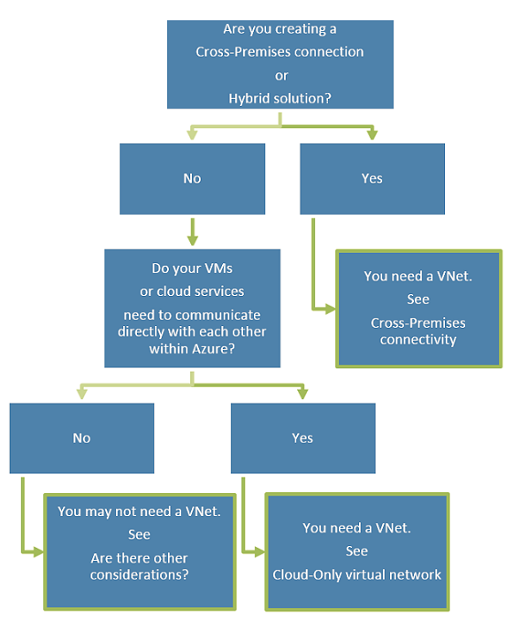
Do you really need a Virtual Network?
Notes:
Note: VM is separated out as IaaS offering.

Slide 19
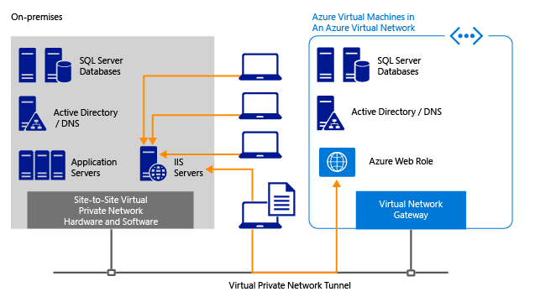
Example of Virtual Network
Notes:
diagram shows how Virtual Network can be used to extend an enterprise network to include Microsoft Azure virtual machines. This brings a great advantage for migrating existing applications to Microsoft Azure. You can easily support hybrid applications that span cloud and on-premises. You can manage your own virtual networks within Microsoft Azure and leverage the hosted VPN gateway to establish connectivity between on-premises and cloud. You can enable virtual machines running in Microsoft Azure to be joined to your corporate domains running on-premises.
As seen in the diagram, within an Microsoft Azure Virtual Network, you can run an Active Directory Domain enabled DNS server in one virtual machine while hosting a SQL Server database in another virtual machine; and your application code can run via a web role managed by Microsoft Azure.

Slide 20
Demo: Provisioning VM
Managing VMs using Azure portal
Notes:
DX Canada Custom Demo: see Demos\001 - Provisioning VM\Provisioning VM - Current Portal.html
-----------------------------------------------------------------------------------------------------
Demo: Provisioning VM
Prerequisites:
A Windows Server 2012 is already provisioned.
Steps:
Open Ibiza portal and click the NEW button at the lower-left corner.
Show the short list of resources. Explain that I can directly create popular resources here such as a Windows Server 2012.
Click on the Everything link.
In Gallery blade, open the Virtual machines category.
Scroll down the view and show images of different types (refer back to slide 9).
Click on Windows Server 2012 R2, and then click the Create button in the overview blade. For non-Microsoft focused audience, consider to pick a Linux image instead.
Fill in the Create VM form and click on the Create button to provision the VM. Explain this will take a few minutes.
Open the already provisioned VM.
Scroll down the blade to show various of information available on the blade.
Click on the Extensions tile.
On the Extensions blade, click on the ADD icon to bring up the extension list. Introduce that VM extensions are installable components to customize VM instances.
Switch to slides to continue with VM extension introduction.

Slide 21

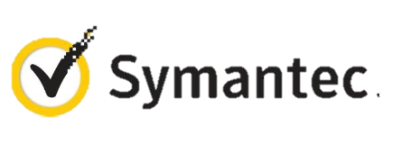


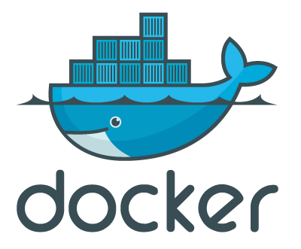

VM Extensions
Installable components to customize VM instances
Enable various DevOps scenarios
Can be added, updated, disabled or removed at any time
Managed via portal, PowerShell and Management APIs
Microsoft Azure
Notes:
Slide Objective:
Introduce VM extensions.
Speaker Notes:
No matter how big the image gallery is, your projects may have specific needs that can’t be satisfied by standard images.
Some components such as anti-virus, configuration management agents are required on most machines for compliance and management purposes.
This allows use to innovate faster to meet with your project needs. And you have flexibility to pick and combine extensions for your goals.
Point out some of existing extensions:
Custom Script Extension, which allows you to download and execute PowerShell scripts.
Chef Extension and Puppet Extension for automated management at scale.
Symantec Endpoint Protection etc. for protection.
Docker (Linux only).
Visual Studio Remote Debugger.

Slide 22
Demo: VM Extension
Add extension to VM instance
Notes:
Demo: VM Extension
Prerequisites:
Azure PowerShell v0.8 or higher has been installed and configured.
Desired Azure subscription has already been selected.
A storage account has been provisioned under the same Azure subscription.
A scripts container has been created under the storage account with public read access.
A helloworld.ps1 PowerShell script has been uploaded to the container. The content of the script is a single line: write-output “Hello World!”
PowerShell environment has been set with large font for easy reading.
A Windows Server 2012 VM has been provisioned.
Steps:
In Azure PowerShell, issue command: Get-AzureVMAvailableExtension | Format-Table -Property ExtensionName, Publisher
The above cmdlet lists existing extensions. Next we’ll see how we can inject an extension to a running VM instance. In the last demo you’ve seen that you can achieve this using Azure Management Portal. Here we’ll do it using PowerShell. In this case, we’ll install Custom Script Extension to an existing Windows Server 2012 VM.
Issue the following cmdlets to get a reference to the virtual machine instance:
$serviceName = “[cloud service that hosts the VM]”
$vmName = “[name of the VM]”
$vm = Get-AzureVM –ServiceName $serviceName –Name $vmName
Next, issue command Get-AzureVMExtension –VM $vm. This lists VM extensions that are currently installed on the VM.
Use the following cmdlet to enable Custom Script Extension, and instruct it to download and execute the helloworld.ps1 (this takes about 20-30 seconds):
Set-AzureVMCustomScriptExtension -ContainerName scripts -StorageAccountName '[your storage account name]' -VM $vm -FileName ‘helloworld.ps1' -Run ‘helloworld.ps1' | Update-AzureVM -Verbose
6. Next, we’ll retrieve and display the script execution result:
$status = Get-AzureVM -ServiceName $serviceName -Name $vmName
$result = $status.ResourceExtensionStatusList.ExtensionSettingStatus.SubStatusList | Select Name, @{"Label"="Message";Expression = {$_.FormattedMessage.Message }}
$result |fl
(see screenshots in hidden slides for references)
(see this blog: http://azure.microsoft.com/blog/2014/07/15/automating-sql-server-vm-configuration-using-custom-script-extension/ for more details on Custom Script Extension)

Slide 23
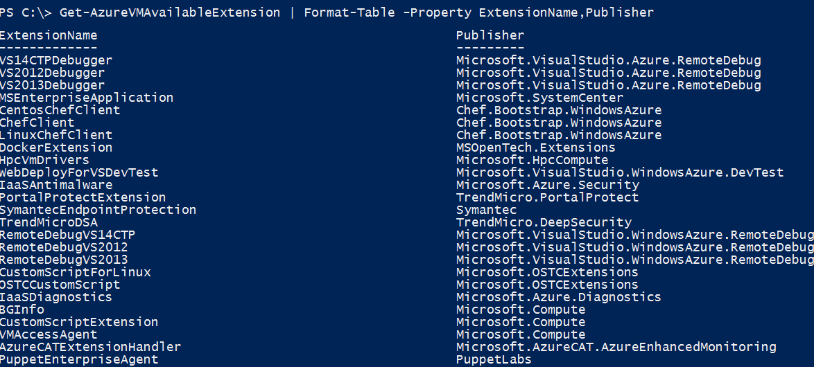
VM Extensions
List available VM extensions
Microsoft Azure

Slide 24
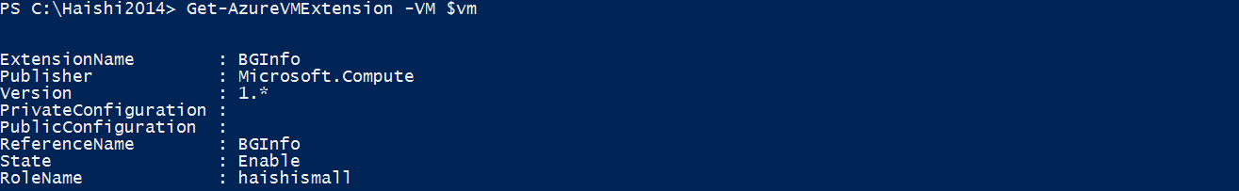
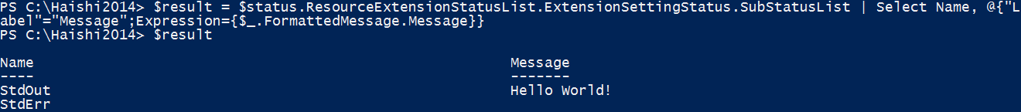
VM Extensions
Before Custom Script Extension is installed
Script execution result
Microsoft Azure

Slide 25
Data Persistence
→ Data Disks
→ Azure Files
Notes:
Slide Objective:
Explain that with Azure VMs you have two methods to add more storage to your VMS or to persist file data either by attaching data disks (vhd files from your storage account) or Azure Files which can be accessed like any SMB share over UNC. This

Slide 26
Disks and Images
OS Images
Microsoft
Partner
User
Base OS image for new Virtual Machines
Sys-Prepped/Generalized/Read Only
Created by uploading or by capture
Disks
OS Disks
Data Disks
Writable Disks for Virtual Machines
Created during VM creation or during upload of existing VHDs.
Notes:
Slide Objective:
Explain the differences between disks and images with VMs
Notes:
OS Images from from the gallery, from the VM Depot or are user supplied, they are used to create new VMs

Slide 27
Image Mobility
On-Premises
Cloud
MyApp.vhd
Notes:
Slide Objective:
Explain the benefits of image mobility
Notes:
One of the key benefits of IaaS is flexibility and control. The Microsoft Azure solution provides the capability of not only moving VHDs TO the cloud but also allows you to copy the VHD back down and run it locally or on another cloud provider. Great for testing out production issues or any other need where you require a copy of the production server.

Slide 28
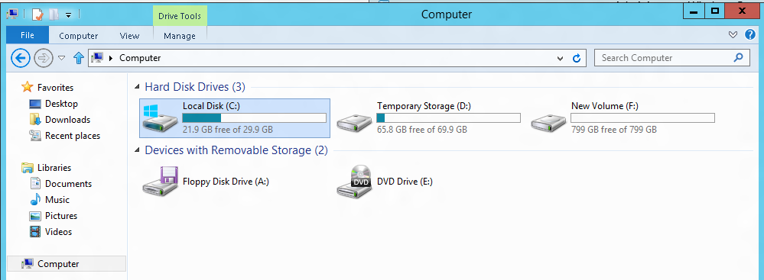
VM disk layout - Windows
OS Disk
Persistent
SATA
Drive C:
Temporary Storage Disk
Local (Not Persistent)
SATA
Drive D:
Data Disk(s)
Persistent
SCSI
Customer Defined Letter

Slide 29
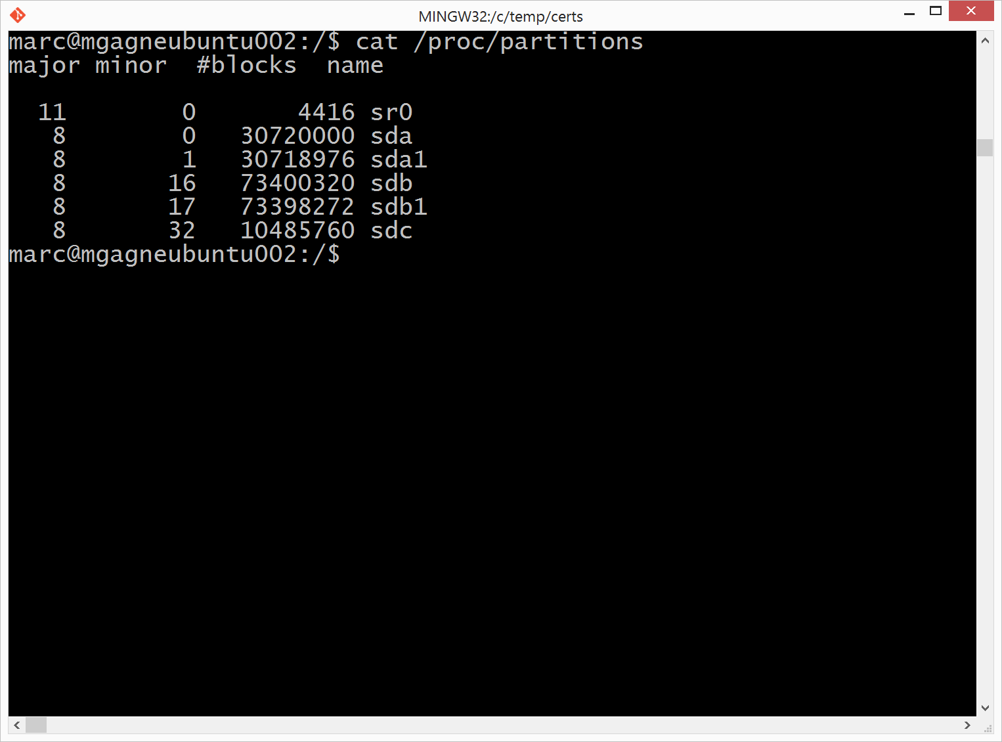
VM disk layout - Linux
OS Disk
Persistent
SATA
Temporary Storage Disk
Local (Not Persistent)
SATA
Ubuntu: /mnt
Others: /mnt/resource
Data Disk(s)
Persistent
SCSI
User Defined Mount Location

Slide 30

Persistent Disks and Highly Durable
Microsoft Azure Storage (Disaster Recovery)
Microsoft Azure Storage
Virtual
Machine
Virtual Machine
Notes:
Slide Objective:
Explain how disks are durable and how Microsoft Azure storage works
Notes:
The OS and Data Disks are stored in Microsoft Azure storage. So in addition to the data being persistent you also get the benefits of storage which means your VHD is replicated 3X’s locally and also 3X’s in a separate data center in the same region (geo-replication)

Slide 31

Azure Files
Shared Network File Storage for Azure
Availability, durability, scalability are managed automatically
Supports two interfaces: SMB and REST
IaaS VM
IaaS VM
IaaS VM
PaaS VM
Azure File Share
(PaaS)
Notes:
Slide Objective:
Explain how Azure Files is essentially a File Share as a Service and accessible by SMB (UNC) and HTTP REST APIs and can be connected to by multiple VMs or PaaS services.

Slide 32
Azure Files - Scenarios
Share data across VMs and applications
Multiple writers, multiple readers using standard file system semantics.
Share settings throughout services
VMs can read settings and files from a common, shared location. These can be updated externally via REST.
Dev/Test/Debug
Very useful to have a shared location for installing applications, setting up VMs, running tools, and keeping notes while developing, testing, and debugging cloud services.

Slide 33
Demo: VM Storage
Managing VM Storage in the Portal
Notes:
DX Canada Custom Demo:
Demos\003 - Azure FileShare\Azure FileShare.html (CURRENTLY INCOMPLETE)
Demos\004 - Add Data Disk\Add Data Disk.html

Slide 34
Azure Files vs Disks
Description | Disk | Azure Files
Relationship with Azure VMs | Required for booting (OS Disk)
Scope | Exclusive/Isolated to a single VM | Shared access across multiple VMs
Snapshots and Copy | Yes | No
Configuration | Configured via portal/Management APIs and available at boot time | Connect after boot (via net use on windows)
Built-in authentication | Built-in authentication | Set up authentication on net use
Cleanup | Resources can be cleaned up with VM if needed | Manually via standard file APIs or REST APIs
Access via REST | Can only access as fixed formatted VHD (single blob) via REST. Files stored in VHD cannot be accessed via REST. | Individual files stored in share are accessible via REST
Max Size | 1TB Disk | 5TB File Share 1TB file within share
Max 8KB IOps | 500 IOps | 1000 IOps
Throughput | Up to 60 MB/s per Disk | Up to 60 MB/s per File Share
Notes:
Speaker Notes:
Unhide to add more details if necessary

Slide 35
Virtual Machine Availability
→ Meaning of 9’s
→ Fault domains, update domains and availability sets
→ Load balancing

Slide 36
Meaning of 9’s
Service Availability(%) | System Type | Annualized Down Minutes | Quarterly Down Minutes | Monthly Down Minutes | Practical Meaning | FAA rating
90 | Unmanaged | 52,596.00 | 13,149.00 | 4,383.00 | Down 5 weeks per year
99 | Managed | 5,259.60 | 1,314.90 | 438.30 | Down 4 days per year | ROUTINE
99.9 | Well managed | 525.96 | 131.49 | 43.83 | Down 9 hours per year | ESSENTIAL
99.99 | Fault tolerant | 52.60 | 13.15 | 4.38 | Down 1 hour per year
99.999 | High availability | 5.26 | 1.31 | 0.44 | Down 5 minutes per year | CRITICAL
99.9999 | Very high availability | 0.53 | 0.13 | 0.04 | Down 30 seconds per year
99.99999 | Ultra availability | 0.05 | 0.01 | - | Down 3 seconds per year | SAFETY CRITICAL
From Generic Requirements for Operation Systems Platform Reliability, Telcordia Technologies System Documentation,GR-2841-CORE and
Federation Aviation Administration Handbook: Reliability, Maintainability, and Availability (RMA) Handbook, FAA-HDBK-006A, Jan 7, 2008.
Microsoft Azure
Notes:
Slide Objective:
There is a lot of misunderstanding of “uptime” and what “five nines uptime” means (which is 5.2 minutes of downtime a year. Most companies should be fine with three nines (9 hours a year).
Notes:
Emphasize that to get 99.95% SLA you will need at least two instances of everything you are running.

Slide 37

Service Level Agreements
99.95% for multiple role instances
4.38 hours of downtime per year
What’s included
Compute Hardware failure (disk, CPU, memory)
Datacenter failures - Network failure, power failure
Hardware upgrades, Software maintenance – Host OS Updates
What is not included
VM Container crashes, Guest OS Updates
Notes:
Slide Objective:
Explain what our SLA is (99.95%), what it includes and what it does not include

Slide 38

Availability Sets
Web Tier
Availability Set
Data Tier
Availability Set
Best Practice
Group each tier of your application into an availability set.
Why use Availability Sets?
By configuring at least two virtual machines in an Availability Set for each tier, you guarantee that at least one virtual machine in each tier will be.
Highly Available
You guarantee that at least one virtual machine in each tier will be available.
Notes:
Slide Objective:
Provide a graphical view of a recommended best practice availability set configuration and explain how availability sets work at a high level (will cover more in next slides)
Notes:
To provide redundancy to your application, we recommend that you group two or more virtual machines in an Availability Set
This configuration ensures that during either a planned or unplanned maintenance event, at least one virtual machine will be available and meet the 99.95% Azure SLA
Virtual machines in the same availability set are distributed across fault & update domains ensuring that at least ONE of the machines in the availability set is running during either planned or unplanned maintenance.
By placing services in an Availability Set, Azure knows to distribute these across upgrade and fault domains which means they will be maintained separately and sequentially.
Availability sets tell the Fabric Controller to place VMs in the same set on different racks for faults and in separate upgrade domains for updates.
This essentially tells the FC not to take the guest OS down of all VMs in the same set for host updates.
Notes
Useful pre-reading here.
http://azure.microsoft.com/en-us/documentation/articles/virtual-machines-manage-availability/

Slide 39
Fault and Update Domains (FD & UD)
Fault Domain #1
(Rack #1)
Fault Domain #2
(Rack #2)
Web Role
(Availability Set)
UD #1
UD #2
Worker Role
(Availability Set)
UD #1
UD #2
Notes:
Slide Objective:
Provide a graphical view of fault and upgrade domains for existing web and worker roles. Use to contrast existing skills with availability sets.
Notes:
You can see that our service is well spread out across both fault and upgrade domains
The loss of a fault domain will not cause a failure of our service nor will the restart or change of an upgrade domain cause a failure of our service
Notes
Useful pre-reading here.
http://blog.toddysm.com/2010/04/upgrade-domains-and-fault-domains-in-windows-azure.html

Slide 40
Virtual Machine Availability Sets
Update Domains are honored by host OS updates
Fault Domain
Fault Domain
Rack
Rack
Availability Set
Virtual Machine
Virtual Machine
IIS1
IIS2
UD #1
UD #2
Availability Set
Virtual Machine
Virtual Machine
SQL1
SQL2
UD #1
UD #2
Notes:
Slide Objective:
Explain availability sets
Notes:
Availability sets tell the Fabric Controller to place VMs in the same set on different racks for faults and in separate upgrade domains for updates.
This essentially tells the FC not to take the guest OS down of all VMs in the same set for host updates.

Slide 41
Load balancing
Load balancing
Multiple VMs share the workload via public facing endpoints
Internal Load balancing
Load balancing between VMs that don’t have public facing endpoints
Microsoft Azure
Internet
Public VIP
Customer vNet
External Load Balancer
Internal Load Balancer
Microsoft Azure
Back end
Front end

Slide 42
Traffic Manager
Failover
For auto swapping between primary and secondary endpoints
Round Robin
To distribute load across a set of endpoints
Performance
To direct clients to the “closest” endpoint in terms of latency
US West
North Europe
Microsoft Azure
North America
Europe
Notes:
Slide Objective:
Explain that basic round-robin load balancing is free in Azure, however Traffic Manager is a more robust solution that includes failover and configurable load balancing at a very low cost
Notes
Failover: Select Failover when you have endpoints in the same or different Azure datacenters (known as regions in the Management Portal) and want to use a primary endpoint for all traffic, but provide backups in case the primary or the backup endpoints are unavailable. For more information, see Failover load balancing method.
Round Robin: Select Round Robin when you want to distribute load across a set of endpoints in the same datacenter or across different datacenters. For more information, see Round Robin load balancing method.
Performance: Select Performance when you have endpoints in different geographic locations and you want requesting clients to use the "closest" endpoint in terms of the lowest latency. For more information, see Performance load balancing method.
Reading
https://msdn.microsoft.com/library/azure/dn339010.aspx

Slide 43

Transform the datacenter Orchestrated disaster recovery to a second site
Microsoft Azure Hyper-V Recovery Manager
Communication Channel
Replication channel: Hyper-V Replica
Windows Server
Primary Site
Recovery Site
Windows Server

Slide 44
Transform the datacenter Orchestrated disaster recovery to a second site or to Azure
Microsoft Azure Site Recovery
Microsoft Azure Site Recovery
Communication Channel
Communication and Replication
Replication channel: Hyper-V Replica
Windows Server
Primary Site
Recovery Site
Windows Server
Primary Site
Windows Server
Key features include:
Automated VM protection and replication
Remote health monitoring
Customizable recovery plans
No-impact recovery plan testing
Orchestrated recovery when needed
Notes:
Speaker Note:
Consider this demo if time permits:
https://microsoft-my.sharepoint.com/personal/mmcspirt_microsoft_com/Documents/Shared%20with%20Everyone/BCDR
The specific demo is Azure Site Recovery – Between Sites.exe

Slide 45


Microsoft Azure Key Vault
Key Vault offers an easy, cost-effective way to safeguard keys and other secrets used by cloud apps and services using HSMs.
You manage your keys and secrets
Applications get high performance access to your keys and secrets… on your terms
Microsoft Azure
IaaS
PaaS
SaaS
Key Vault
Import keys
HSM
Microsoft Confidential
Notes:
Azure Key Vault offers an easy, cost-effective way to safeguard keys and other secrets used by cloud apps and services. With Key Vault, customers can streamline key management and maintain control of keys used to access and encrypt their data.

Slide 46
Enhance data protection and compliance
Increased security
HSM protected keys
Compliance
Monitoring
Encrypt keys and small secrets like passwords using keys protected by tightly controlled and monitored Hardware Security Modules (HSMs)
Import or generate your keys in HSMs for added assurance – so that keys stay within the HSM boundary
Comply with regulatory standards for secure key management, including the US Government FIPS 140-2 Level 2 and Common Criteria EAL 4+
Monitor and audit key use through Azure logging – pipe logs into HDInsight or your SIEM for additional analysis (coming soon)
Microsoft Confidential
Notes:
Enhance data protection and compliance
Encrypt keys and small secrets like passwords using keys stored in tightly controlled and monitored Hardware Security Modules (HSMs)
Import or generate your keys in HSMs for added assurance. Key Vault is designed so that keys stay within the HSM boundary
Comply with regulatory standards for secure key management, including the US Government FIPS 140-2 and Common Criteria EAL 4+
Monitor and audit key use through Azure logging – pipe logs into HDInsight or your SIEM for additional analysis (coming soon)

Slide 47
Scaling
→ Manual from portal
→ From command line
→ Via Management APIs & SDKs
→ Autoscale

Slide 48
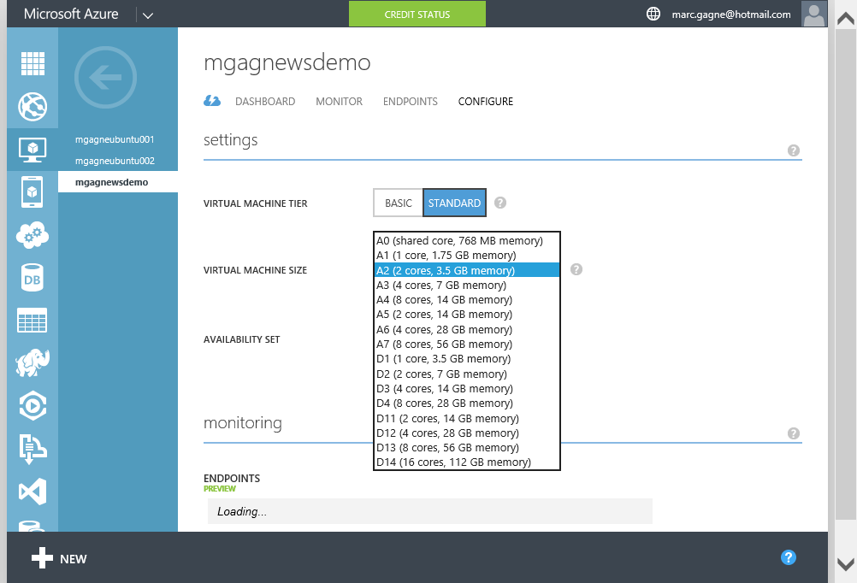
Scaling Up - Portal
Notes:
Slide Objectives:
Simply explain that it’s very easy to scale up a VM through the portal simply by configuring a larger machine size.
Speaker Notes:
You can easily change between basic & standard
You can scale up to G (Godzilla) class or down to a shared core and very little memory indeed depending on your needs
Changing the tier or size will result in downtime as a new system is prepared, the disks are detached and re-attached to the new system and it is then booted and swapped for your current system.

Slide 49
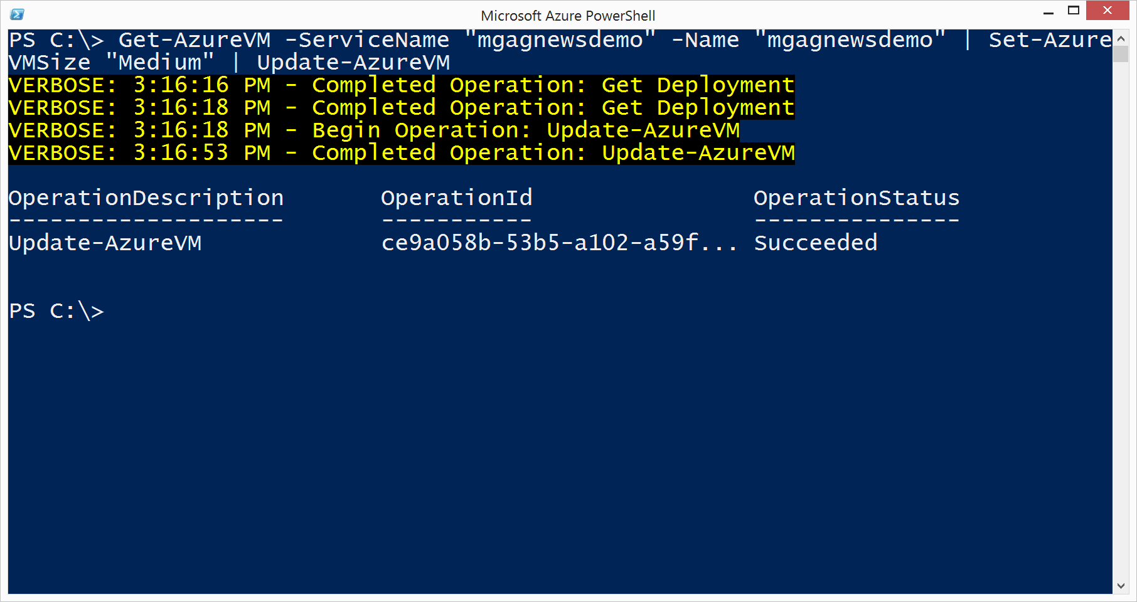
Scaling Up – Command Line
Notes:
Slide Objectives:
Explain that you can also change a VMs scale through Powershell (Windows only) with the Set-AzureVMSize command.

Slide 50
Scaling Up – APIs & SDKs
HTTP Service Management API
Method | Request URI
PUT | https://management.core.windows.net/<subscription-id>/services/hostedservices/<cloudservice-name>/deployments/<deployment-name>/roles/<role-name>
Service Management SDKs for .NET, PHP, Ruby, Python, Java, Go & more
Notes:
Slide Objectives:
Explain that you can also change a VMs scale (and many other properties of a VM) through the HTTP based Azure Service Management API or through one of the many SDKs including .NET, PHP, Python and more.

Slide 51
Auto Scale
Doesn’t auto scale size but rather # of instances
Turns existing instances on/off as configured
Why is that good? You don’t pay when stoppe
Scale either by metric or by schedule
Configure how quickly or slowly to scale
Autoscale is configured per cloud service

Slide 52
Demo: Configuring Autoscale
Managing VM autoscaling using Azure portal
Notes:
DX Canada Custom Demo: see Demos\002 - Autoscaling VM\Autoscaling VM.html

Slide 53
Virtual Networks

Slide 54
Azure Virtual Networks
→ A protected private virtual network in cloud
→ Extend enterprise networks into Azure
→ Cross-premises connectivity

Slide 55
Virtual Network Scenarios
Hybrid Public/Private Cloud
Enterprise app in Microsoft Azure requiring connectivity to on-premise resources
Enterprise Identity and Access Control
Manage identity and access control with on-premise resources (on-premises Active Directory)
Monitoring and Management
Remote monitoring and trouble-shooting of resources running in Azure
Advanced Connectivity Requirements
Cloud deployments requiring IP addresses and direct connectivity across services
Microsoft Azure

Slide 56






Cross-premises Connectivity
Site-to-site
Create a secure connection between your on-premises site and your virtual network
Point-to-site
Create a secure connection via VPN to your virtual network
ExpressRouteTM
Create a private connection between Azure data centers and infrastructures on your premises or in a co-location environment.
Connect at an ExpressRoute location (Exchange Provider facility)
Direct connect via a Network Service Provider
Microsoft Azure

Slide 57
Demo: Virtual Network
Point-to-Site connection
Notes:
Demo: Point-to-Site connection
Prerequisites:
Follow step 1-15 below to prepare the environment.
(http://haishibai.blogspot.com/2013/05/walkthrough-file-sharing-between-your.html)
Steps:
Run through steps 17-21 in the following steps. If time permits, you can start with step 16.
Log on to (current) Microsoft Azure Management Portal.
On command bar, click on NEW button, then select NETWORKS->VIRTUAL NETWORK->CUSTOM CREATE menu.
On Virtual Network Details page, enter network NAME as pointtosite, create or select a AFFINITY GROUP, then click next arrow.
On DNS Servers and VPN Connectivity page, check Configure Point-to-Site VPN, then click next arrow:
On Point-to-Site Connectivity page, click next arrow.
On Virtual Network Address Spaces page, click on add gateway subnet button, and then click on check icon to complete network creation.
After the virtual network has been created, open its DASHBOARD page, and the click CREATE GATEWAY icon to create the dynamic routing gateway.
Add a new Windows Server 2012 virtual machine to the virtual network. Note that when you specify user credential, make sure to use the same user id and password of your local account. This is because the virtual machine on Microsoft Azure is not under your domain controller, and we are using the same user credential on both local and virtual machines to allow file sharing.
As the virtual machine is cooking, let’s create two self-signed certificates: one for root, and another for client identification. During the following steps we’ll need to upload the root certificate to Microsoft Azure so Microsoft Azure can validate the client machine using the certificate chain.
Launch Developer Command Prompt for VS2012 as administrator. Change current folder to a folder where you want to keep the generated certificates. Here I’ll use folder c:\books.
Use command makecert -sky exchange -r -n "CN=MyFakeRoot" -pe -a sha1 -len 2048 -ss My to create root certificate.
Use command makecert -n "CN=MyLaptop" -pe -sky exchange -m 96 -ss My -in "MyFakeRoot" -is my -a sha1 to create client certificate.
Launch certmgr. Export the root certificate as a MyFakeRoot.cer file (without private key).
[Optional] if you are configuring VPN for another client, you’d need to install the client certificate on target machine.
Go back to Microsoft Azure Management Portal. On DASHBOARD page of the virtual network, click on link Upload client certificate to upload the root certificate. Note at this point the gateway should have been created.
After certificate has been uploaded, you can download and install VPN client from the DASHBOARD page (AMD64 Client link for 64-bit machines, x86 Client link for 32-bit machines).
After VPN client has been installed, you can see the VPN connection on your Windows network connection list. Click on the network to connect. When prompted by the VPN client, click Connect button to continue.
[Optional] Now you can use ipconfig/all to verify if VPN connection has been successfully established (look for PPP adapter).
Log on to the virtual machine, create a new Share folder under c:\. Share the folder with the user you specified when you created the virtual machine.
On Management Portal, record the virtual machines private IP on its DASHBOARD page. In my case the IP is 10.0.1.4.
Now you can use Explorer on your local machine and access the shared folder by \\10.0.1.4\Share.

Slide 58
But wait, there’s more!
Notes:
Slide Objectives:
Explain that Azure VMs is just one of many services in Azure

Slide 59


Microsoft Azure Services
Access Control
Layer
AD
Multifactor
Authentication
BizTalk Services
Service Bus
CDN
Traffic Manager
Virtual Networks
Express Route
Integration
layer
API Mgmt
Mobile Services
Websites
Cloud Services
VM
Media Services
Notification Hubs
Scheduler
Automation
Application
layer
Blobs
Tables
Queues
SQL Database
Machine Learning
HD Insight
Caching
Backup and Recovery
StorSimple
Data Layer
Notes:
Slide Objectives:
Explain that asides from Virtual Machines (IaaS) most of Azure is PaaS which means you can treat it like a set of building blocks that you can use to construct your product while focusing on your core business by not developing solutions such as an account solution (AD), security (AD, Multifactor Authentication), Mobile back end (Mobile services), Notification systems (Notification Hubs) etc.

Slide 60
How to get started
Notes:
Slide Objectives:
Explain that Azure Websites isn’t the only Platform as a Service offering on Azure, in fact we are the leaders in PaaS offerings

Slide 61
Try $200 Azure Trial aka.ms/azuretrial
Read documentation azure.com
Watch 10 minute videos friday.azure.com
Train Virtual Academy aka.ms/cloudmva

Slide 62
Startups
Notes:
Slide Objectives:
Explain that beyond the free trial we have a pretty awesome program for startups

Slide 63

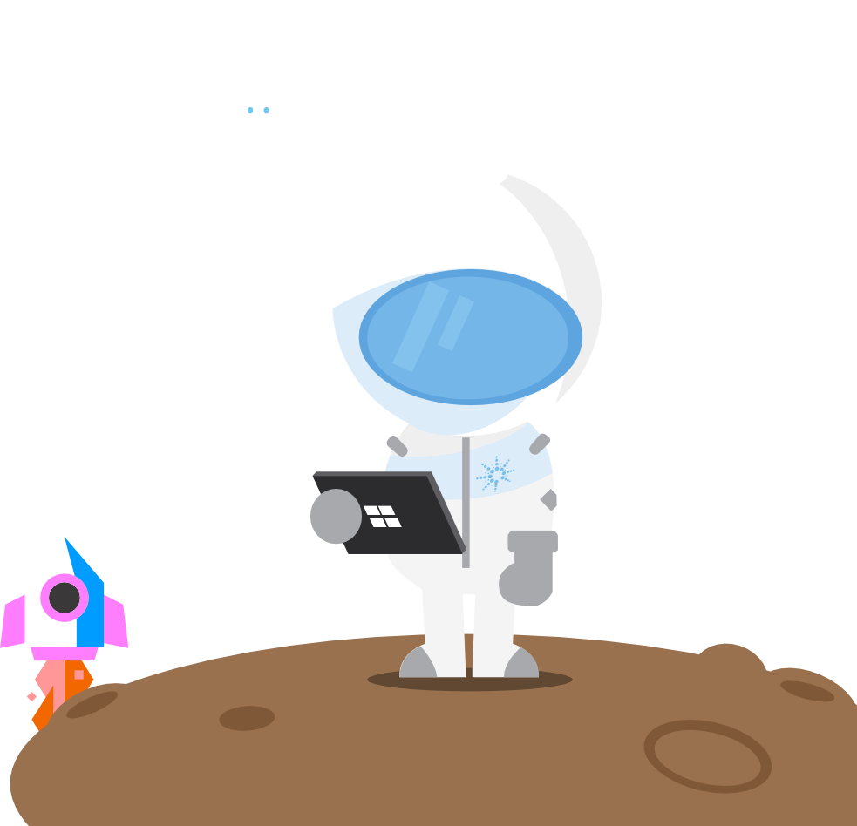

BizSpark
Notes:
Slide Objectives:
Explain that BizSpark is the name of the program (set of offers) we have for tech startups
Video:
Watch this video (http://aka.ms/bizsparkvid) to get familiar with BizSpark and our offers

Slide 64
BizSpark is for tech startups
Who are developing software/technology for themselves
Who are less than 5 years old
Who are making less than one million in revenue annually
Who are privately held
Notes:
Slide Objectives:
Explain that BizSpark is for tech startups who are developing 1st party IP/Hardware/Software.
The #1 reason startups are denied their application to BizSpark is that they are consultants/contract workers etc.
In short if you company is developing something it will sell (not on a contract for someone else) then you are set.

Slide 65
BizSpark is not for startups
Who are consultants
Who primarily do contract work
Who primarily do IT Services
Who design/build websites
Notes:
Slide Objectives:
Explain that these are the common reasons a startups application is denied from BizSpark
We get asked “what if a consulting/contracting company otherwise meets all the requirements as they are now working on a 1st party app. The answer is connect with us (bizsparkca@Microsoft.com) as we can make an exception provided the benefits we give them only apply to that work.

Slide 66



What do BizSpark startups get?
Notes:
Slide Objectives:
Explain that the core of the benefits include cloud credits, free MS software & access to a loaner pool of devices for dev/test.

Slide 67









$150/month for 3 years in Azure Credits
Virtual Machines
Windows & Linux
Website & Web Apps
.NET, Node.js, PHP, Python & more
Publish with Git, GitHub, FTP & more
Mobile Services
Identity, Notifications, Storage & more
Windows, iOS, Android & Web
40% Discount on paid usage
Notes:
Slide Objectives:
Key points to hit are
$150 a month in azure credits (per developer) while an active member of BizSpark (max 3 years)
There are Windows and Linux virtual machines on Azure including ready to deploy images of Windows Server, Ubuntu, CentOS and more.
Websites (PaaS) support for .NET, Node.js, PHP, Python and more
Mobile Services for iOS, Android, Windows & Web
If you go past the credits you get a 40% discount on paid usage

Slide 68
Free Software & Services for 3 years
MSDN Ultimate Subscriptions (~$13,000 each)
Windows
Visual Studio Ultimate
Office 2013
Office 365 Developer Subscription
Visual Studio Online
Developer Store accounts
& more
Notes:
Slide Objectives:
Key points to hit are
The core of the BizSpark offer is free MSDN Ultimate Subscriptions (again one per developer)
Normally these sell for over $13,000 each to our enterprise customers
Startups get them for free!

Slide 69



More developers == more benefits
BizSpark Admin /
Developer 1
$150/month in Azure Credits
Free Microsoft Software etc.
MSDN Subscription
BizSpark
$150/month in Azure Credits
Free Microsoft Software etc.
Developers 2+
MSDN Subscription
Notes:
Slide Objectives:
Explain that the benefits scale when they add more developers
Each developer gets their own MSDN subscription (and therefore their own benefits) including their own Azure subscription

Slide 70
Maximize your benefits
Use one Azure subscription for dev
Use another Azure subscription for production
Use another Azure subscription for betas, previews and custom demos
If 4 isn’t enough you can always request more by emailing bizspark@microsoft.com
Notes:
Slide Objectives:
Explain that you can have one developer apply their benefits towards a dev environment, another to a test env, another to a production env
Need more? Just email bizspark and explain why

Slide 71

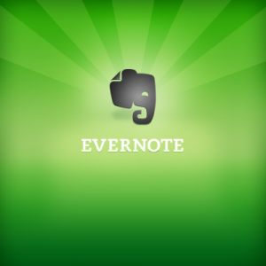

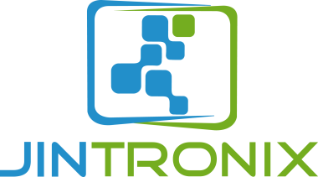



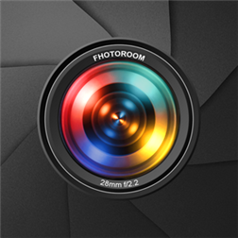

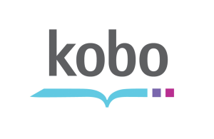


Join the over 2,800 tech startups benefiting from BizSpark & Microsoft Azure today
Fhotoroom
Notes:
Slide Objectives:
Explain that over 2800 startups are active or have graduated through the program!
Currently there are over 1900 startups active in the program (03.16.2015)
Feel free to edit the startups being shown to highlight local ones

Slide 72

thank you
Join bizspark.com
Learn aka.ms/bizsparkguide
Connect bizsparkca@microsoft.com

Slide 73

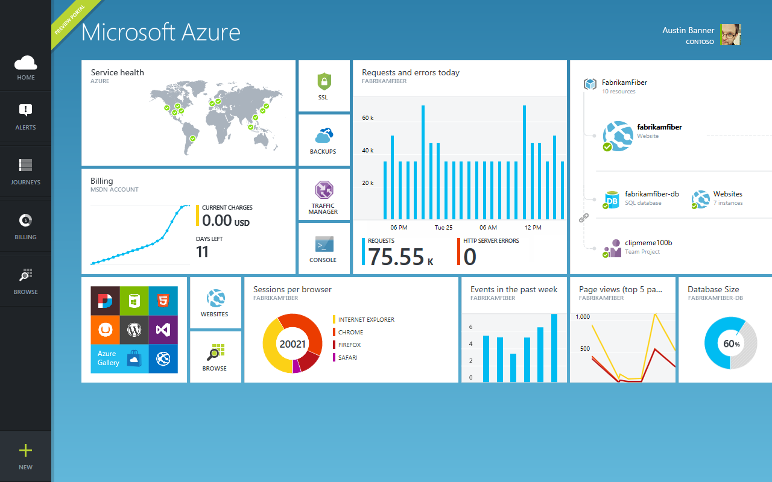
Get started
Visit azure.microsoft.com

